Slide 1
Lecture 12 – Denial-of-Service
Chad Mourning
Taken from Textbook Chapter 7

Slide 2
Denial-of-service (DoS)
A denial-of-service (DoS) attack is an attempt to compromise availability by hindering or blocking completely the provision of some service. The attack attempts to exhaust some critical resource associated with the service.
An example is flooding a Web server with so many spurious requests that it is unable to respond to valid requests from users in a timely manner. This chapter explores denial-of-service attacks, their definition, the various forms they take, and defenses against them.

Slide 3
Scale of DDoS
In 2002, a “large” attack was 400Mbps of traffic.
Mbps vs. MBps – 8
Aside: kibibytes
In 2015, a “large” attack (against the BBC) was 600 Gbps
In 2016, DynDNS was attacked with 1.2 TBps

Slide 4
Attackable Resources
Bandwith
Input or Output
System Resources
If you hit them with requests for an expensive task, you could peg CPU or make RAM swap
Application Resources
A specific app may be memory capped less than the system. 32-bit applications cap at < 4GB of addressable space.

Slide 5
Ping Flooding Attacks
Ping Flooding Is Common
Use –f
You’ll notice if you try this on Linux it requires sudo
You don’t want a person who managed to get access to a random account to use your machine to be able to Ping Flood
Downside, Ping sends a response, so you are also DoSing yourself
But does it have to?

Slide 6
Source Address Spoofing
Helps mask your identity
At the end of the day, packets are just bytes
Someone has to set them, why can’t that be you.
If you can make your own packets, why can’t you lie in the from field
Spoofing froms in e-mail is easy too, I’d make that an assignment, but it’s already an assignments in CS4440.
Maybe a helpful ISP doing packet inspection will notice that the source address isn’t the one they assigned you and drop it.
This is called egress filtering
A lot of them don’t do this, because it also breaks proxies

Slide 7
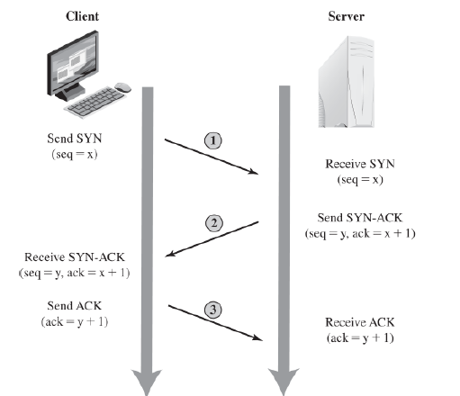
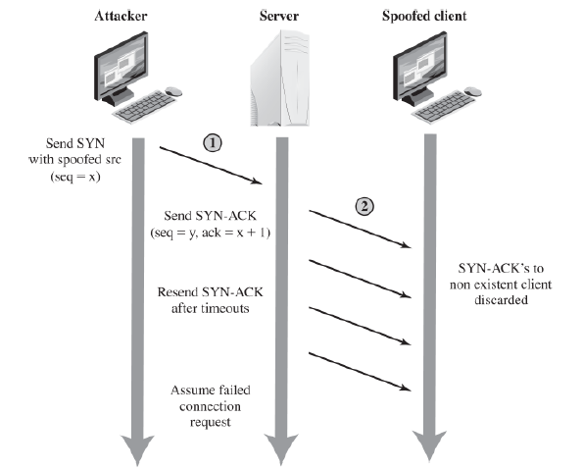
SYN Spoofing Attacks
SYN packets initiate a TCP session.
If you are limited to 64k of outgoing ports, what happens when someone hits you with 64k connection requests?
If you are spoofing sources, make sure it’s somewhere that won’t RST

Slide 8
Other Flooding Attacks
Other ICMP Types
UDP Flooding
Echo Service is a popular target
SYN Flooding
Not the same as SYN Spoofing

Slide 9
Distributed Denial-of-Service
Zombies infected by a virus form a Botnet
Sometimes sold to the highest bidder
Aside: Darknet - https://en.wikipedia.org/wiki/Darknet
Increases bandwidth of attack
Decreases chance of being shut down
An early example of DDoS software was Tribe Flood Network (TFB) by Mixter
Did all of the aforementioned flood attacks
Didn’t bother with source spoofing
Who cares if the bots get in trouble?

Slide 10
Application-Based Bandwidth Attacks
SIP Flooding
VoIP uses the Session Initiation Protocol
Easy to spoof and invites are resource intensive to process
HTTP-Based Attacks
HTTP Flooding
Could just be hits to a webpage
Could be GETs for a large file.
Spidering to ensure you don’t get flagged for sending the same request repeatedly
Slowloris
Targets HTTP processing threads (another resource)
HTTP connections have to end with a blank line. What happens if you start a request and never finish? You can slowly send additional characters of the request, or additional headers.
Countermeasures include timeouts and delayed binding.

Slide 11


Slide 12
Reflection Attacks
Possible without infecting zombies.
If I send a packet that requires a response, with a spoofed source address to multiple people multiple people will respond to it under normal rules.
Effectively DDoSing the spoofed address by proxy
Doesn’t DoS the intermediary, if you have enough intermediaries
So they have no reason to block you
Large packet responses are better.
So not just a Ping
Start a UDP stream service?

Slide 13
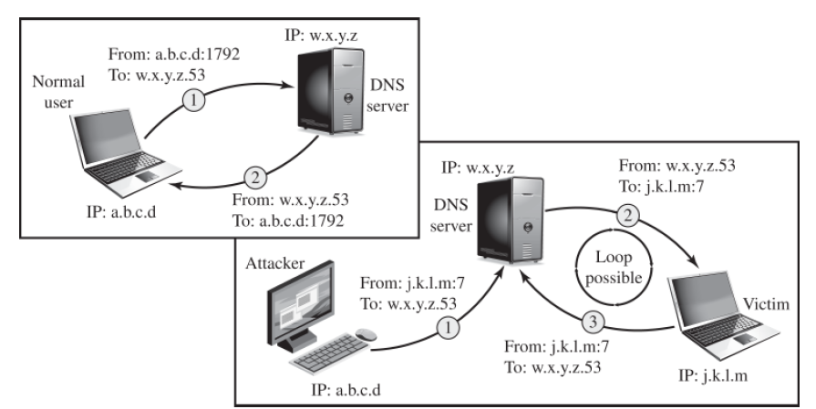
DNS Reflection
Send a DNS request spoofing the source address and source port as 7 (echo).
Fairly easy to filter
You should be able to come up with an iptables rule with source port of 53 and destination port of 7.

Slide 14
Amplification Attacks
A subset of Reflection Attacks
Some protocols allow “broadcasts” as opposed to targeting a specific IP. So, if you machine hosts multiple IP, you may respond with multiple packets.
Similarly, if your server hosts multiple services, you may be able to get 1 intermediary to respond with multiple packets.

Slide 15
DNS Amplification
Amplification based on size.
DNS requests are usually around 60-bytes
DNS responses implementing extensions can be around 4000 bytes

Slide 16
A few other DoS attacks
Cyberslam
Poison Pill

Slide 17
Cyberslam
If you can hit a database server with an expensive request.
Why not do a Full Outer Join on every table?

Slide 18
Poison Packet
Ping of Death
Teardrop Attacks

Slide 19
Defenses Against DoS
Impossible to prevent entirely if you can generate enough legitimate traffic
Slashdotted / Reddit Hug of Death
Attack Prevention / Pre-emption
Enforcing policies for resource consumption.
Scaling on demand.
Attack Detection and Filtering
Fingerprinting suspicious behaviors.
Filtering packets (Iptables)
Attack Source Traceback and Identification
Sometimes you can manage this during the attack and block them.
Sometimes it’s part of the reaction
Attack Reaction
How do you recover?
Have you tried turning it off and back on again?

Slide 20
Egress Filtering
Cons
Can break proxies
Costs performance
But if it prevents a DDoS attack going through your network it probably “pays for itself”
But at least with DDoS you can blame someone else.

Slide 21
Rate Filtering
ISPs have the ability to rate limit your packets
Who really needs to send that many ping packets?
Yeah, can be good for diagnostic reasons, but that’s still a lot of traffic.

Slide 22
SYN Cookies
Alternative version of the TCP 3-way handshake
SYN Spoofing (not to be confused with SYN flooding) is meant to fill up session tables.
Can we apply the delayed binding concept from slowloris prevention to TCP handshakes?
Instead of storing the information in your session tables:
Send it back to the client (encrypted) in a cookie, and then let them send that cookie back if they really want to connect (and verify the signature).
You can always wait to switch to this mode until your table fills up, since the en/decrypt steps consume additional computational resources
Alternatively, if your table is full, just start dropping the oldest incomplete connections (although this could DoS slow connections)
Random dropping is also a thing, assuming that if your table is full, you are probably being attacked, so most of the table is fake, probabilistically a random drop will be an illegitimate entry
You can always use a bigger table or shorter timeouts as well

Slide 23
Captchas
Block expensive operations behind authentications mechanisms.

Slide 24
Response
Have a plan.
Probably need to interface with 3rd parties like your ISP
Probably need to do this in a way that doesn’t involve your network
Facebook outage from a couple years back by borking their BGP

